Slide 1

COST-OF-LIVING ANALYSIS
Power bi presentation

Slide 2
Table of Content
Data Description
Data Cleaning
Graphs & Analysis
Conclusion

Slide 3

DATA DESCRIPTION
The dataset contains 56 columns, including information about cities, Countries, a variety of cost-related factors, such as real-estate prices and supermarket prices. The dataset is a useful tool for cost living analysis because it is intended to provide an extensive perspective of the economic element of different regions,

Slide 4

DATA CLEANING
As, the data was in a huge amount, so it is also important to clean the data before going further. The first step was to check if there were any blank entries in both rows and columns. The data had many blank entries so it was removed for accurate analysis. The columns didn't had the headers which makes it difficult to understand, headers were also entered. The data type pf each columns is specified while loading the data in Power BI from excel. New calculated columns were added for some specified results.

Slide 5

GRAPHS & ANALYSIS
For the analysis of the data visually, number of graphs are created with the help of Power BI which will be shown in the next coming slides. In the coming slides there will be the visual analysis and its conclusion.

Slide 6
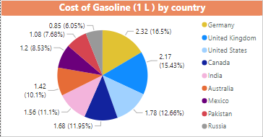


Cost of Gasoline
In the first visual of the pie chart few countries were selected to show the maximum cost of gasoline from which Germany has the highest percentage.
But overall Hong Kong has the highest cost of gasoline while Libya has the lowest in the city Tripoli.

Slide 7
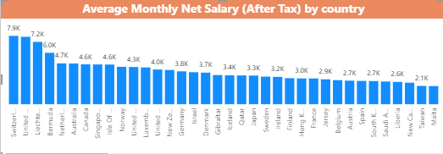


Average Monthly Net Salary (USD)
Switzerland, Zug has the highest cost of average monthly net salary which is about 7.94 K.
While Cuba, Havana has the lowest which is 35.75.
Second highest is united states and third one is Liechtenstein.

Slide 8
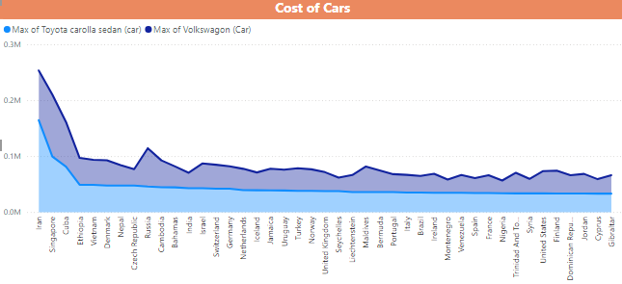
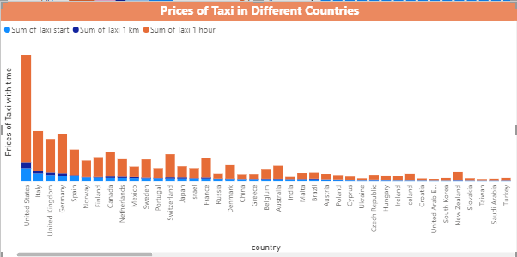
Cost Of Cars & Taxi Fares
Prices of two different kinds of cars were provided for different countries from which IRAN has the highest rate and after IRAN, SINGAPORE and third is CUBA.
While the taxi fares for different time spam United States has the highest cost and then Italy and United kingdom.

Slide 9
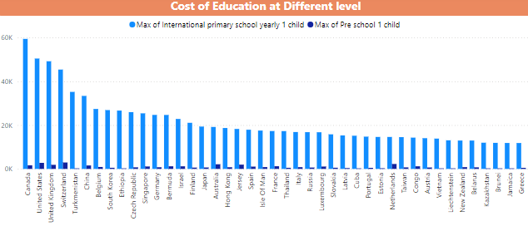


Price of Education
Education is a basic need that should be in reach to every other person easily.
Canada, Edmonton has the most expensive education for international primary school yearly for 1 child and Finland, Jyvaskyla has the lowest cost which is a good thing.

Slide 10
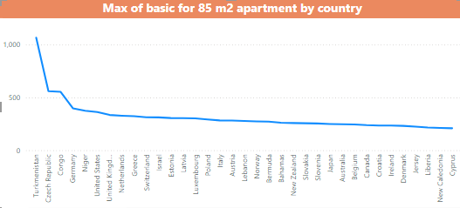


Cost of Basic Needs for 85m2 Apartment
Basic needs include electricity, heating, cooling, water, garage.
In this category Turkmenistan, Ashgabat is the most expensive as it has the highest cost for the basic needs while Venezuela, Maracay has the least expense.
Czech republic, Congo and Germany has high price after Turkmenistan.

Slide 11
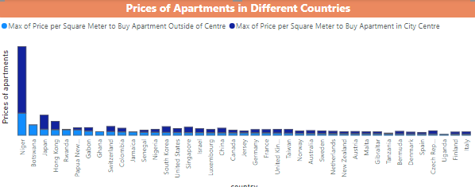
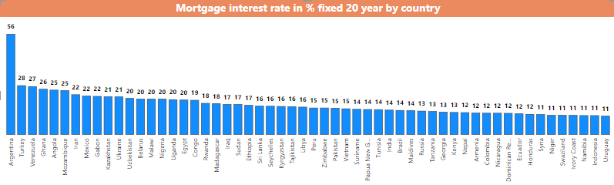


Cost of Real-Estate & Mortgage
Prices of per square meter to buy an apartment inside and outside the city can be seen in the first visuals which that Nigeria have the maximum cost.
As for the Mortgage interest rate Percentages (%), Yearly, for 20 Years Fixed-Rate, Argentina have the highest rate and then Turkey. While Finland have the lowest cost.

Slide 12
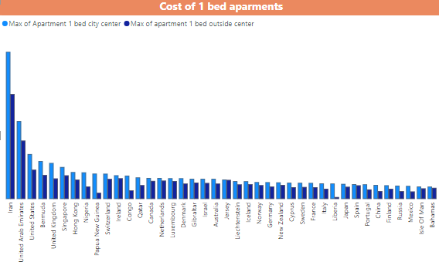
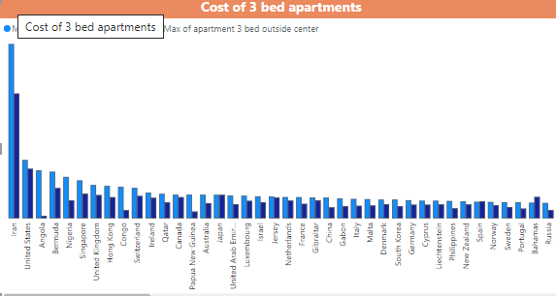
Prices of 1 & 3 Bed Apartments
In the graph where prices of 1 bed apartment inside and outside city is shown, the country that has the highest rate is IRAN, UAE, US and Bermuda.
In the second visual the countries that has the highest cost of 3 bed apartment inside and outside city are also IRAN, US, ANGOLA, BERMUDA.

Slide 13
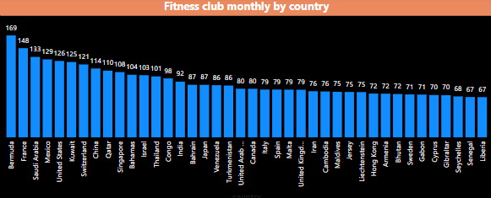
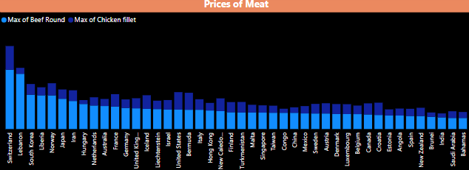
Prices of Health & Meat
Fitness clubs are really important to maintain a healthy body and lifestyle, which is costly the most in BERMUDA,FRANCE and SAUDI ARABIA.
Taking proteins in form of meat is also essential and has the highest amount in SWITZERLAND, LEBANON and South Korea.

Slide 14
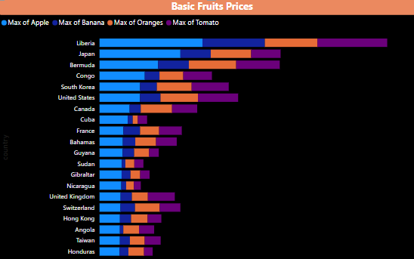
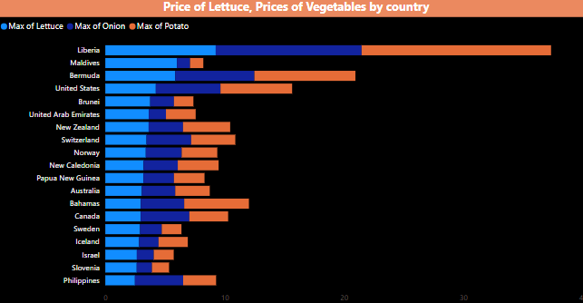
Cost of Food Items
The prices of some basic fruits like apple, banana, oranges, tomato are given from which LIBERIA and JAPAN has the highest prices.
And some vegetables like lettuce, onion and potatoes are also most expensive in Liberia and the second one is Bermuda.

Slide 15
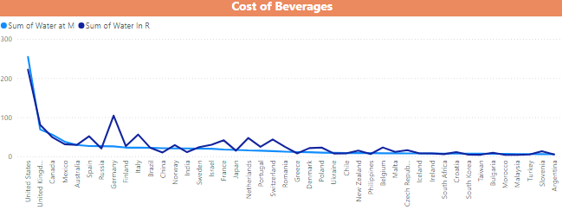
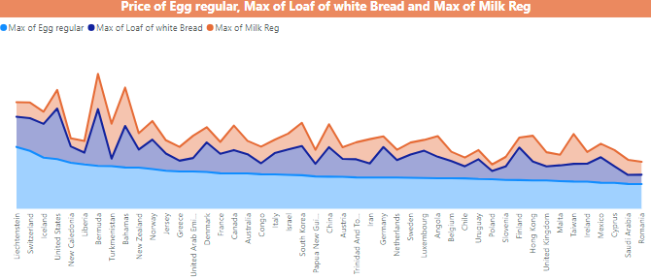
Prices of Beverages & Breakfast Items
The cost of water at restaurant and market, and the price of regular eggs, loaf of white bread and regular milk is given.
The graph clearly shows that the United state have the highest cost of water and then United kingdom.

Slide 16
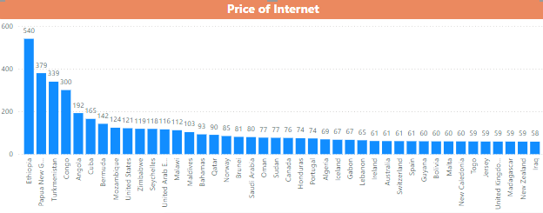


Cost of Internet Bills
Internet is also one of the essentials for a variety of purposes like education, work, political updates and socialize but it is also expensive in countries like ETHIOPIA, Dire Dawa. The least cost of internet is in UKRAIN, KONOTOP.

Slide 17
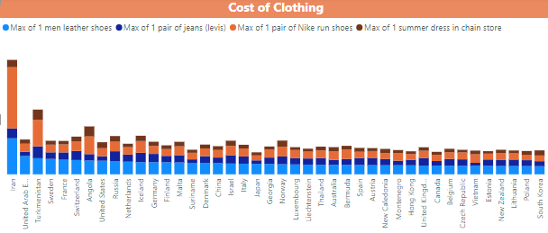
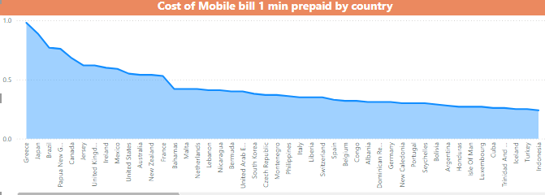
Cost of Clothing & Mobile bills
Cost of clothing which include 1 leather shoes, 1 pair of Nike running shoes, 1 summer dress and 1 pair of jeans. These stuff are most expensive in IRAN, UAE and Turkmenistan.
Price of mobile bill 1 min, the highest rates are in GREECE, JAPAN and BRAZIL.

Slide 18

CONCLUSION
After analyzing all the data it is to be concluded that some countries are really expensive to survive because even the price for the basic needs are extremely high as compared to the rest of the countries. Basic rights, like education, food, clothing, water are so expensive while they should the at an appropriate level with other regions, The regions that have low level of average salary rate but expensive necessities should give a rise to the salary portion.

